Slide 1
C29PE Economics for Professionals
Week 8 – The Economy as a System
Sloman et al., 2023, Chapter 29

Slide 2
Session Aims
To introduce key concepts and concerns in macroeconomics including economic growth, inflation, unemployment and business cycles
To introduce the concept of national income as a method of measuring aggregate economic activity
To identify the key macroeconomic policy objectives of the government
To discuss and apply two macroeconomic frameworks, namely the circular flow of income and the aggregate demand-aggregate supply (AD-AS) model

Slide 3
References
Sloman et al (2023)
  Chapter 29.1 – 29.5
  Box 29.1
Important!
  The PowerPoint slide deck for Week 8 lecture provides a guideline of the topics you need to know. However, the materials in the slide deck are insufficient if you wish to excel in the course
  To do well, please do not forget to read the relevant sections of the core textbook
  Please also ensure that you follow economics news regularly as these sources could be used as examples to supplement your answers during assessments

Slide 4
Macroeconomic policy objectives
High and stable economic growth.
Low unemployment.
Low rates of inflation.
The avoidance of balance of payments deficits and excessive exchange rate fluctuations (Week 11 lecture).
A stable financial system (Week 9 lecture).
The avoidance of excessively financially distressed sectors of the economy, including government (Week 9 lecture).
Often objectives in conflict

Slide 5
Economic growth
Economic growth describes the rate of change in the level of an economy’s output from period to period (percentage change)
Usually measured over short periods, such as 12 months or 3 months
How do we measure the value of a nation’s output? With the gross domestic product (GDP) (see section on ‘Additional reading’ on how to calculate GDP)
To be able to compare changes in output from one period to the next we must eliminate those changes in GDP that result from changes in prices: we use real GDP

Slide 6
Nominal vs real GDP
Nominal GDP measures GDP in the prices of the time (also known as ‘current prices’). So, UK’s nominal GDP in 2024 is the value of the UK’s output at 2024 prices.
  No account is made for the effect of inflation
Real GDP is adjusted for inflation. GDP is measured in the prices that ruled in some particular year – the base year. GDP in 2015 prices would be known as ‘GDP at constant 2015 prices’. This then enables us to see how much real GDP had changed from one period to another by eliminating increases (or decreases) in prices.

Slide 7
Short-term economic growth
Starting from data in the form of time series graphs
  Economic growth – in the short term and in the business cycle
    Rate of increase in output, usually over one year – perhaps 2 – 3%
      Measure this in real terms – as if prices do not change
  What could go wrong?
    Business cycle – short term fluctuations in growth across whole economy
      Recession: two or more quarters when growth is less than zero

Slide 8
Annual economic growth rates

Slide 9
Long-run economic growth
Typically economies grow – and contract – at the same time
Although growth rates fluctuate, most economies experience positive growth over the longer term. In other words, most economies have output paths that trend upwards over time.
For growth to be sustained over the longer term, an economy’s capacity must increase. Hence, differences in long-term economic growth rates reflect differences in the growth of the productive capacity of economies.

Slide 10
Output paths from 1965

Slide 11
Unemployment
Proportion of labour force out of work, but looking for jobs
  Standardised measures set by ILO/OECD
    based on quarterly labour force surveys
  Alternative is claimant unemployment – relies on rules for receipt of social entitlements – different from ILO count
    Many changes to eligibility – so tends to difficult to compare over time, between countries
Notes:
8

Slide 12
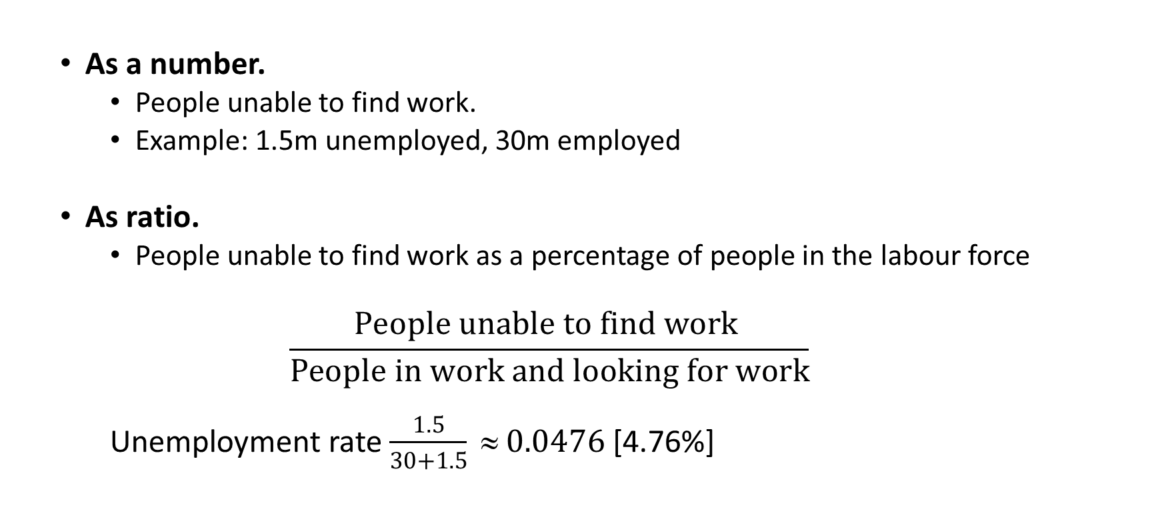
Measuring Unemployment
  As a number.
    People unable to find work.
    Example: 1.5m unemployed, 30m employed
  As ratio.
    People unable to find work as a percentage of people in the labour force
  $$\frac{People unable to find work }{People in work and looking for work}$$
    Unemployment rate $\frac{1.5}{30+1.5} ≈ 0.0476$ [4.76%]

Slide 13
Standardised unemployment rates

Slide 14
Unemployment and the labour market
Aggregate supply of labour: number of people willing to work at the current wage rate
  May be less than the total workforce
Aggregate demand for labour: number of people that employers are willing to hire at the current wage rate
    Assumes that all workers are the same – (reasonable??)
Equilibrium: wage set to aggregate supply, demand are equal
  Equilibrium unemployment: share of labour force unwilling to work given current wage
  Disequilibrium unemployment: occurs when wage above market clearing level – and ‘sticky’ wages don’t fall

Slide 15
Types of equilibrium unemployment
Why might someone not choose to work at the current wage?
  Frictions: takes time to move between jobs
  Search: looking for a job – and looking for workers
  Structural change – the places where there are jobs change
  (regional unemployment)
    and so do the types of jobs which are available (technological change)
    or the types of jobs which are vacant (because of changes in demand)
  Seasonal: work no longer available (Santa Claus in July)

Slide 16
Types of disequilibrium unemployment
Wage stickiness – real wage above market clearing rate
  Trade unions negotiating on behalf of members?
    Unlikely given labour market reforms, pressures of globalisation
    Could be some effect when labour supply increases, but not demand
  Very little evidence that minimum wages cause unemployment
    Possible explanation in terms of multiple equilibria
Demand deficient unemployment
  In recession, aggregate demand low – firms may lay workers off
  Or firms may close, making staff redundant

Slide 17
Equilibrium and disequilibrium unemployment
Average (real) wage rate
AS_{L}
Disequilibrium
unemployment
N
b
a
c
W₂
Equilibrium
unemployment
e
f
W_{e}
AD_{L}
No. of workers
O
Notes:
17

Slide 18
Costs of Unemployment
Direct financial cost of the loss in individual earnings
Unemployment benefits are a cost borne by taxpayers. There may also have to be extra public spending on benefit offices, social services, health care and the police.
Firms lose the profits that could have been made, had there been full employment.
The government loses tax revenues, since the unemployed pay no income tax and national insurance and, given that the unemployed spend less, they pay less VAT and excise duties.
Other workers lose any additional wages they could have earned from higher national output.

Slide 19
Inflation
A general rise in prices throughout the economy.
  With price stability, changes prices are informative for decision makers
  With high inflation, they are not
Inflation tends to rise in periods of rapid economic growth: firms respond to the higher demand, partly by raising output, but partly also by raising prices.
Conversely, in a recession, inflation is likely to fall: firms, faced with falling demand and rising stocks, are likely to be unwilling to raise prices and may even cut them.

Slide 20
Inflation
Definition: annual or quarterly increase in level of prices
Measures of inflation
  GDP deflator
    price index based on value of all final transactions in economy
    Includes capital goods (investment), government purchases, export prices, doesn’t include imports
  consumer price index: Consumer Prices Index, includes imports, doesn’t include exports
  wage inflation – with difference between rate of wage increases and consumer prices important for well-being
  other measures (e.g. commodity price inflation)

Slide 21
Inflation rates

Slide 22
Economic Volatility and the Business Cycle
Typically economy shows period in which
  Expansion begins; growth accelerates; peaks out;
  Economy then starts to slow down, contracts in recession, reaches trough
Traditional description – business cycle
  Captures fluctuations in actual growth through the phases of expansion and contraction

Slide 23
The business cycle
Actual growth tends to fluctuate. This cycle of expansion and slowdown causes fluctuations in the path of output.
  4 phases:
  the upturn
  the expansion
  the peaking out
  the slowdown or recession
Long-term output trend. If firms on average operate with a ‘normal’ degree of capacity utilisation, the trend output line will be the same as the potential output line. If the average level of capacity that is unutilised stays constant from one cycle to another, the trend line will have the same slope as the full-capacity output line.
If unemployment and unused industrial capacity rise from one peak to another, then the trend line will move further away from the full-capacity output line
Notes:
4

Slide 24
A hypothetical business cycle
Full capacity
output
3
National output
4
3
2
Actual
output
4
2
1
1
O
Time
Notes:
24

Slide 25
A hypothetical business cycle
Full capacity
output
Trend
output
National output
Actual
output
O
Time
Notes:
25

Slide 26
Actual versus potential growth
The published statistics on growth show actual growth: the percentage change in national output over a period of time. This usually is measured over a year (12 months) or a quarter (3 months).
Potential growth is the speed at which the economy could grow. It is the percentage increase in the economy’s capacity to produce over a period of time: the rate of growth in potential output.

Slide 27
Potential output
Potential output (i.e. potential GDP) is the level of output when the economy is operating at ‘normal capacity utilisation’.
This allows for firms having a planned degree of spare capacity to meet unexpected demand or for hold-ups in supply.
It also allows for some unemployment as people move from job to job.
Because potential output is normal-capacity output, it is somewhat below full-capacity output, which is the absolute maximum that could be produced with firms working flat-out.

Slide 28
Output gap
The difference between actual and potential output is known as the output gap.
If actual output exceeds potential output, the output gap is positive: the economy is operating above normal capacity utilisation.
If actual output is below potential output, the output gap is negative: the economy is operating below normal capacity utilisation.

Slide 29
A hypothetical business cycle
Output gap
greater than zero
Trend
output
National output
Actual
output
Output gap
less than zero
O
Time
Notes:
29

Slide 30
Output Gaps, 1970–2023
Note: Figures for Germany based on West Germany up to 1991; Figures from 2022 based on forecasts
Source: Based on data from AMECO database (European Commission, DGECFIN, May 2022) and various forecasts

Slide 31
The Circular Flow of Income
The Inner Flow → Two parties: households and firms
Firms pay money to households in the form of wages and salaries, dividends on shares, interest and rent. These payments are in return for the services of the factors of production – labour, capital and land – that are supplied by households.
Households, in turn, pay money to domestic firms when they consume domestically produced goods and services.
There is thus a circular flow of payments from firms to households to firms and so on.
Notes:
8

Slide 32



The Circular Flow of Income
The inner flow
Firms
Consumption of
domestically
produced goods
and services (C_{d})
Factor
payments
Households
Notes:
8

Slide 33
The Circular Flow of Income
Withdrawals
  net saving (S) – out of wage income – reducing consumption – bank deposits
  net taxes (T) – charge against income
  imports (M) – money flowing to other countries to pay for goods and services
Injections
  investment (I_{d}) – bank lending used by firms for capital investment
  government expenditure (G_{d}) – government purchase of goods and services – not transfer payments such as pensions and social entitlements
  export expenditure (X_{d}) – money flowing from other countries to pay for goods and services
Notes:
8

Slide 34
The Circular Flow of Income
The inner flow
Withdrawals
  net saving (S)
  net taxes (T)
  imports (M)
Injections
  investment (I_{d})
  government
  expenditure (G_{d})
  export expenditure (X_{d})
INJECTIONS
Export
expenditure (X_{d})
Investment (I_{d})
Consumption of
domestically
produced goods
and services (C_{d})
Government
expenditure (G_{d})
Factor
payments
BANKS, etc
GOV.
ABROAD
Net
saving (S)
Net
taxes (T)
Import
expenditure (M)
WITHDRAWALS
Notes:
8

Slide 35
Relationship between injections, withdrawals
No reason to expect investment to equal savings
  Different people making different decisions
  Same with exports, imports – and government spending need not equal taxation
  As a result, planned injections may not equal planned withdrawals
Where injections are greater, higher expenditure, so income increases, then expenditure increases through consumption
  Where withdrawals are greater, lower expenditure, so income decreases, expenditure falls through consumption
Equilibrium: income equals expenditure
  Or injections equal withdrawals
Notes:
9

Slide 36
Aggregate demand-Aggregate Supply (AD-AS) framework
Aggregate demand → total spending by economic agents in an economy at a given set of prices
  Aggregate demand = Consumption + Investment + Government Spending + Exports - Imports
Aggregate supply → total quantity of goods and services produced by firms in an economy at a given set of prices

Slide 37
Shape of aggregate demand curve
Shows combinations of output, prices in circular for which income, expenditure are equal – equilibrium in circular flow
Three reasons for downward slope
  Higher prices mean that foreign goods are cheaper – substitution effect
    Exports fall, imports increase
  If inflation is not expected to last, defer consumption, investment to future
    An inter-temporal substitution effect
  People feel poorer because money buys less – real balance effect
    This is like the income effect of a price rise
Notes:
13

Slide 38
Downward sloping aggregate demand curve
    substitution effect
    inter-temporal substitution effect
    real balance effect
Price level
AD
O
Real national income (GDP)

Slide 39
Shape of aggregate supply curve
Why is it upward sloping?
  Assumption of constant input prices – so ‘sticky’ wages
  Think about short-run production: fixed use of some inputs
    Also technology of production is set
    Diminishing marginal returns to factors
  If firms are able to set higher prices, higher profit margins
    But in expanding output, costs will also rise

Slide 40
Upward sloping aggregate supply
AS
Price level
  diminishing returns
  growing shortage of certain variable factors
O
Real national income (GDP)

Slide 41
Aggregate demand and aggregate supply with flexible prices
AS
If the price level is initially P₂, the excess demand will cause the price level to rise to P_{e}
Price level
P_{e}
b
a
P₂
AD
O
Y_{e}
Real national income (GDP)

Slide 42
Shifts in the AD-AS equilibrium
Demand shifts
  Changing expenditure in the economy –
    Consumption, business investment, exports, imports, government spending
Supply shifts
  Changing capacity in the economy
    Technology of production, factor availability will change slowly
    Likely to be response to changes in factor prices – wages, real interest rates
Notes:
14

Slide 43
Applications 1: Demand pull vs cost push inflation
What circumstances lead to increasing inflation?
Demand pull inflation
  It is caused by continuing rises in aggregate demand.
Cost push inflation
  It is associated with continuing rises in costs and hence continuing leftward (upward) shifts in the AS curve.
  If firms face a rise in costs, they will respond by raising prices, and by cutting back on production
  Output and employment tend to fall.
  Rises in costs may originate from trade unions pushing up wages, firms with monopoly power raising prices to increase profits or increases in international commodity prices.

Slide 44
Demand-pull inflation
AS
Price level
P₂
P₁
AD₂
AD₁
O
Q₁
Q₂
Real national income (GDP)
Notes:
44

Slide 45
Cost-push inflation
AS₂
AS₁
Price level
P₂
P₁
AD
O
Q₂
Q₁
Real national income (GDP)
Notes:
45

Slide 46
Interaction of demand-pull and cost-push inflation in a spiral
Why is happening here?
Why might costs and output rise together?
AS₃
AS₂
AS₁
P₃
Price level
P₂
P₁
AD₃
AD₂
AD₁
O
Real national income (GDP)
Notes:
46

Slide 47
Applications 2: Business cycles
What causes the cycle?
We can see that business cycles are irregular with differences in
    length (period)
    differences in the magnitude (amplitude) of the phases
What causes the cycle?
  Changes in spending, and so output – fluctuations in aggregate demand
  Changes in aggregate supply – the capacity to produce output
    changes in technology,
    political shocks – especially regulatory environment,
    health emergency

Slide 48
Aggregate demand and the business cycle
In the expansionary phase of the business cycle (phase 2), aggregate demand grows rapidly. There will be relatively rapid growth in output, with a positive output gap emerging, unemployment will fall as firms take on more labour and inflation will increase.
At the peak of the cycle (phase 3), unemployment is probably at its lowest and output at its highest (for the time being). But growth has already ceased or at least slowed down. Inflation and balance of payments problems are probably acute.
As the economy moves into phase 4 (let us assume that this is an actual recession with falling output), the reverse will happen to that in phase 2. Falling aggregate demand will make growth negative and demand-deficient unemployment higher, but inflation is likely to slow down and the balance of payments will improve.
Notes:
4

Slide 49
The business cycle and macroeconomic variables
Boom: high output, low unemployment
but
high inflation, current account deficit
Actual
output
Trend
output
3
Real GDP
2
4
3
4
2
1
1
Low inflation, current account surplus
but
low output, high unemployment
O
Time

Slide 50
Summary
A government is tasked with fulfilling a number of macroeconomic policy objectives. Some of these objectives can be conflicting
The key macroeconomic concerns covered today include inflation, unemployment, economic growth and business cycles
There are 3 methods for calculating national income
The circular flow of income in Week 1 is reintroduced in this session, and shows the movement of incomes between various components of an economy
The AD-AS model captures the price and production levels of an economy. Inflation and business cycles are better understood with this model

Slide 51
Additional reading materials (will not be covered in class)

Slide 52
Measuring National Income and Output
There are three ways of measuring GDP
  The incomes which people receive (income basis)
  The receipts from the sale of goods and services (expenditure basis)
  The value of invoices for goods and services (production basis)
Show these in a simple circular flow model

Slide 53
The circular flow of national income and expenditure
(1) Production
Good and services
Money
(2) Incomes
(3) Expenditure

Slide 54
The production method
Add up the value of all the goods and services produced in the country, industry by industry.
We must be careful to avoid double counting. For example, if a manufacturer sells a television to a retailer for £200 and the retailer sells it to the consumer for £300, how much has this television contributed to GDP?
The sum of all the values added by all the various industries in the economy is known as gross value added (GVA) at basic prices.
How do we get from GVA to GDP?
GDP is GVA plus taxes on products minus subsidies on products.

Slide 55
The income method
Focus on the incomes generated from the production of goods and services.
The sum of all values added at each stage of production. Value added is simply the difference between a firm’s revenue from sales and the costs of its purchases from other firms.
  Wages and salaries received from employment
  Surpluses made by organisations
  Then add taxes paid and subtract subsidies received

Slide 56
The expenditure method
Measure spending on goods and services across sectors
  Household consumption, business investment, government purchases of goods and services, net exports
    Exports – spending in other countries on goods produced in this country
    Imports – spending in this country on goods produced in other countries
  In terms of symbols, AE = C + I + G + (X – M)

Slide 57
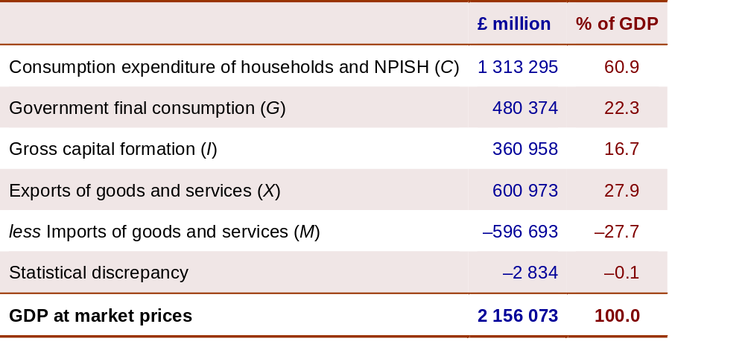
UK GDP at market prices
by category of expenditure: 2020
Source: UK Economic Accounts time series dataset (National Statistics)

Slide 58
Measuring National Income and Output
Gross national income at market prices (GNY)
  = GDP at market prices + Net income from abroad
Net national income (NNY)
  = GNY at market prices − Depreciation
Household disposable income
  = GNY at market prices − Taxes paid by firms + Subsidies received by firms − Depreciation − Undistributed profits − Personal taxes + Benefits

Slide 59
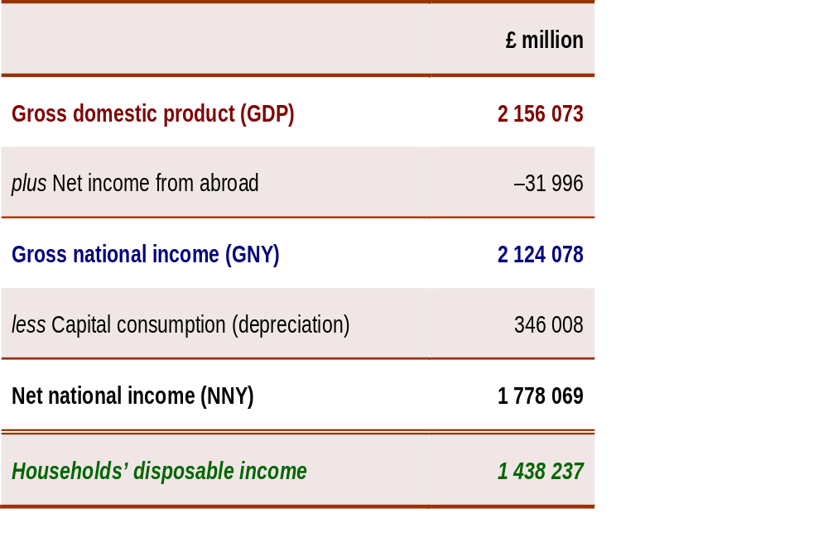
UK GDP, GNY and NNY and Households’ disposable income at market prices: 2020
Source: UK Economic Accounts time series dataset (National Statistics)

